Slide 1
Maths at Kingsway Infant School
29th September 2025

Slide 2
Our Curriculum Aims
To develop mastery and fluency in mathematics so that pupils develop conceptual understanding and the ability to recall and apply knowledge rapidly and accurately.
To reason mathematically by following a line of enquiry, finding relationships and generalisations, and developing an argument, justification or proof using mathematical language.
To solve problems by applying mathematics to a variety of routine and non-routine problems with increasing sophistication, including breaking down problems into a series of simpler steps and persevering in seeking solutions.
To develop positive attitudes to all areas of mathematics through active learning and promote life-long learning skills.
To encourage questioning, reasoning and logical thinking skills through challenges and problem solving.
To develop the child’s mathematical vocabulary and enable each child to develop confidence and competence in all aspects of mathematical study.
To follow/use the National Curriculum to ensure coverage of all aspects of mathematics.

Slide 3
How has maths changed?
Focus on using manipulatives
Focus on the understanding of mathematical processes
Focus on key vocabulary
Focus on fluency and mastery
Children being able to answer word problems and problem solving questions

Slide 4
Our Curriculum
ESSENTIALmaths sequences are designed by Herts for Learning experts. They support the delivery of a spiral curriculum, in which learning is built upon step by step, sequence by sequence and year on year. The materials are aspirational and ensure progression and coverage throughout Early Years and Years 1-6.
Concrete, pictorial, abstract approach

Slide 5
The strands of our curriculum
Number and place value
Number- addition and subtraction
Number- multiplication and division
Number –fractions
Measurement
Geometry
Statistics

Slide 6
What does this look like?
Learning sequences are designed to cover National Curriculum statements and key concepts, through small learning steps with a mastery approach.
They aim to develop conceptual understanding and procedural fluency in parallel, including speaking frames, practice examples, games and problem solving opportunities for the children to build upon their prior learning.
Teachers deliver careful modelling with concrete resources and pictorial representations to develop the children’s understanding of structures and connections in mathematics. Pupils actively participate through purposeful questioning, whole class discussions, talk partners, and by using their own resources to demonstrate their thinking.
Regular recording opportunities encourage pupils to represent and internalise their learning, and the children are encouraged to use models, drawings, symbols and concrete resources.
Opportunities are built-in for children to think deeply and develop explicit reasoning and problem-solving skills, so that they can confidently apply their learning to new contexts.

Slide 7
Resources to aid understanding
Cherry model
Dienes
Tens frame
Counters
Cubes
Bead strings
Cuisenaire rods
Numicon
Number lines
Digit cards/arrow cards

Slide 8
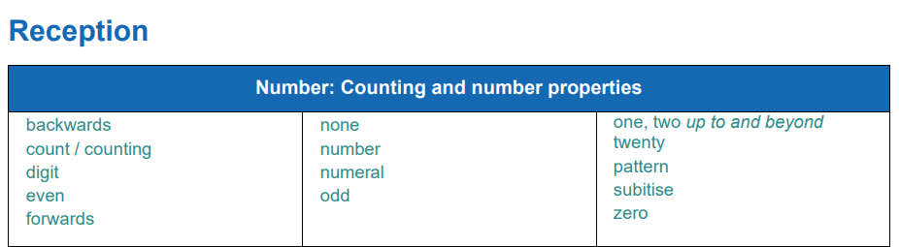
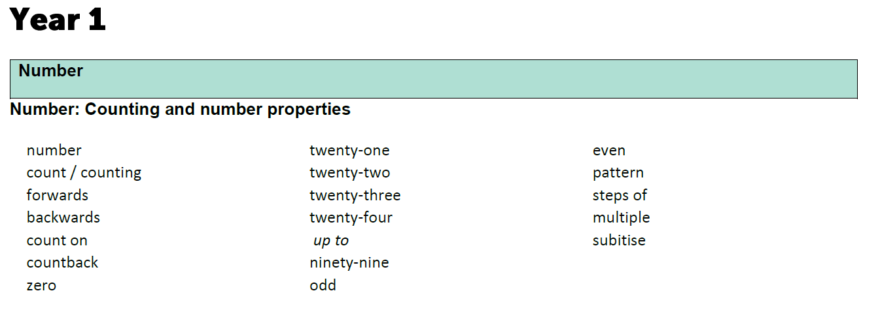
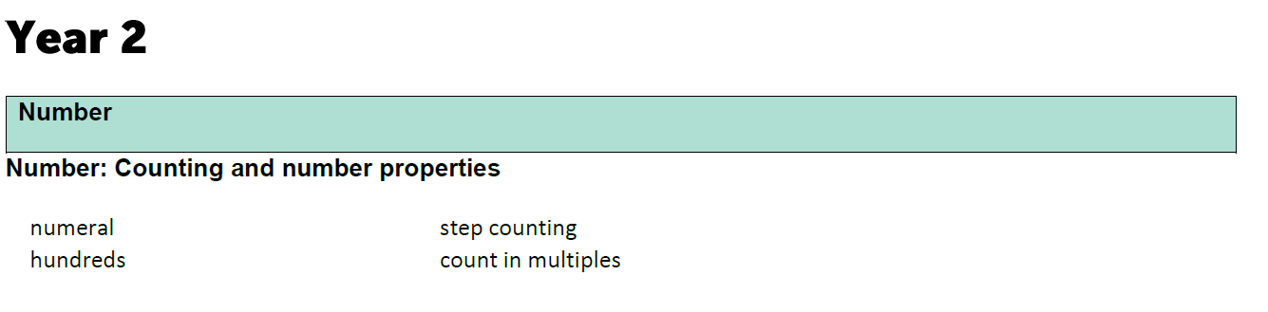
Key Vocabulary

Slide 9
Assessment
Assessment takes place throughout lessons, when marking and during discussions with children.
Planning caters for the needs of all children and adaptations can be made during lessons or after lessons to support children.
Formal Assessment:
Arithmetic and reasoning.
In Key Stage 1, at the end of each term, more formal assessments take place so that we can see whether children have retained knowledge and to see if there are whole class or group gaps to address.
At the end of Early Years, children are assessed against the Early Learning Goals. The attainment of your child will be reported to you in their end of year report.
At the end of Key Stage 1, the SATs are no longer statutory. Teacher’s will continue to use their teacher assessment to inform your child’s attainment at the end of the Key Stage.

Slide 10
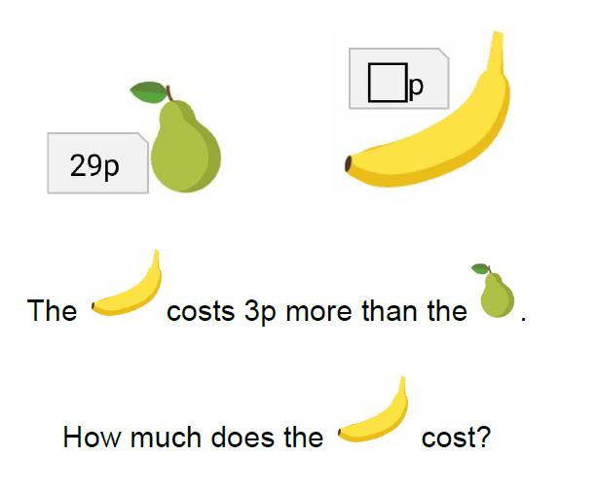
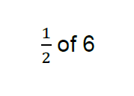
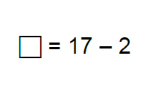
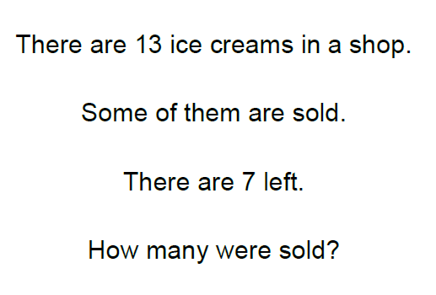
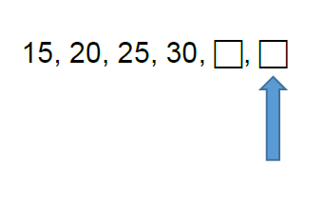
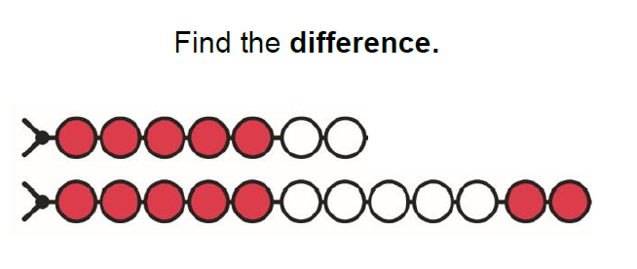
Year 1…

Slide 11
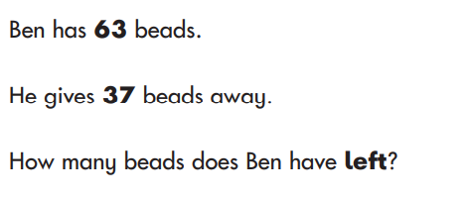
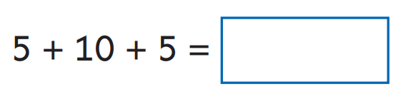
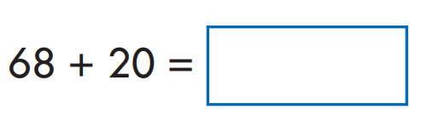
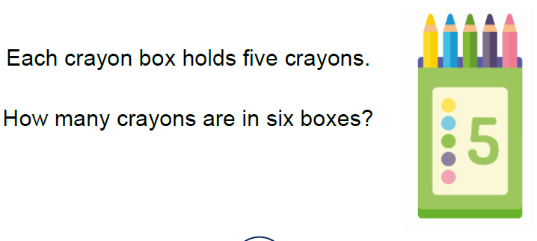
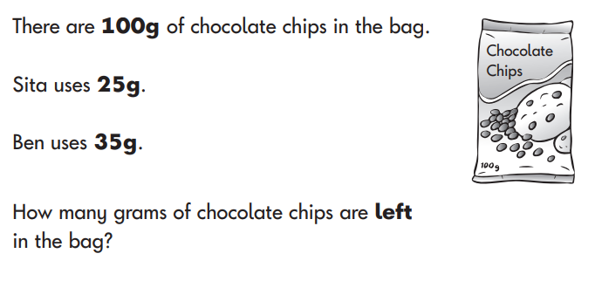
Year 2…

Slide 12
How you can help at home…
Play board games
Play card games
Go on number hunts
Counting- steps, items, getting children to lay the table and count the correct number, cars, houses, animals etc.
Read stories
Shape hunt
Open a shop and use coins
Practise telling the time
Year 2 – times tables practise 2, 5, 10s
Useful links: TopMarks, Marvellous Me, Maths Bot

Slide 13
